Slide 1

East Tennessee:
Foundation to Frontier
A Regional Competitiveness Strategy — Tourism Cluster · Nuclear Cluster
Knoxville–Oak Ridge Region · East Tennessee · 2026
Notes:
[~0:20] Open: East Tennessee — a single connected region running from frontier heritage to the technology frontier. One story: foundation, keystone, frontier.

Slide 2
Framework for Presentation
How this regional strategy is structured
1
Region & Value Proposition
Unique strengths and differentiation
2
Clusters to Leverage or Strengthen
Where the regional opportunity is
3
Strategic Priority — and Why
Supported with evidence and examples
4
Execution
12-month plan and 90-day next steps
5
Accountability
How me measure success
6
Visualization
The future of the region if we succeed
Notes:
[~0:25] We'll walk these five beats: value proposition, the clusters, the strategic priority with evidence, execution, and the vision.

Slide 3
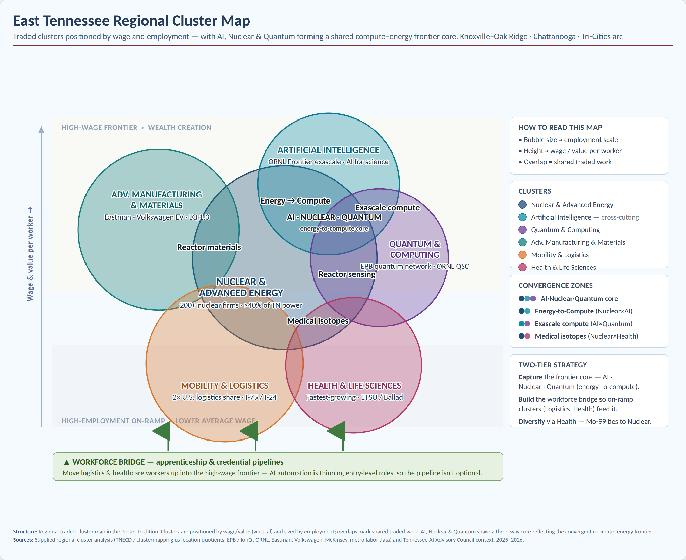
Foundation → Keystone → Frontier and where they converge
New Nuclear Cluster
Tourism is the fiscal foundation · New Nuclear the keystone · AI & Quantum the frontier — linked by the energy-to-compute core.
Notes:
[~0:55] Three clusters, one system. Tourism funds it, nuclear powers it, AI/quantum is the upside. The overlaps are the strategy — especially AI·Nuclear·Quantum.

Slide 4
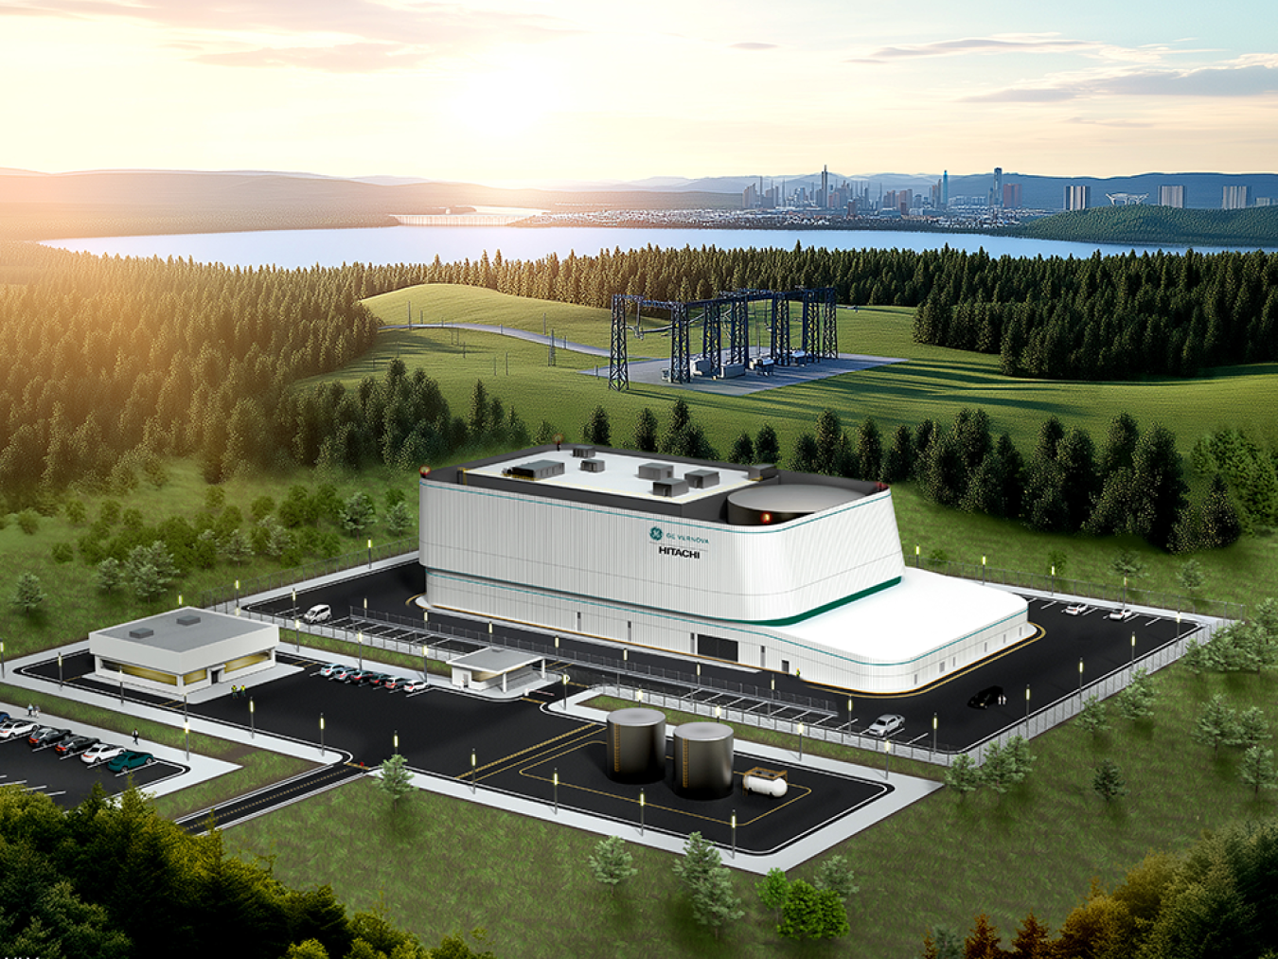
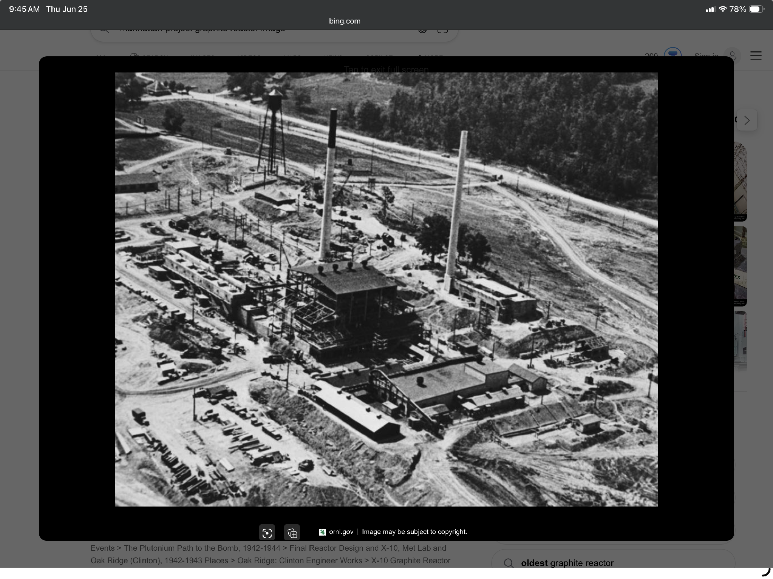
Frontier heritage, modern commercialization
East Tennessee is America's nuclear commercialization corridor — where next-generation nuclear moves from discovery to deployment — and East Tennessee's most accessible mountains-city-water destination.
Unique strengths
Advanced energy innovation + real-world power (TVA)
World-class R&D and talent — ORNL, University of Tennessee
Deep supplier capability + live deployment sites
Iconic visitor economy and exceptional quality of place
“Companies come here to build, test, validate, commercialize, and scale.”
Notes:
[~0:55] The differentiator: not just research — commercialization and deployment in one connected region. Davy Crockett with a laptop: frontier grit, modern value capture.

Slide 5
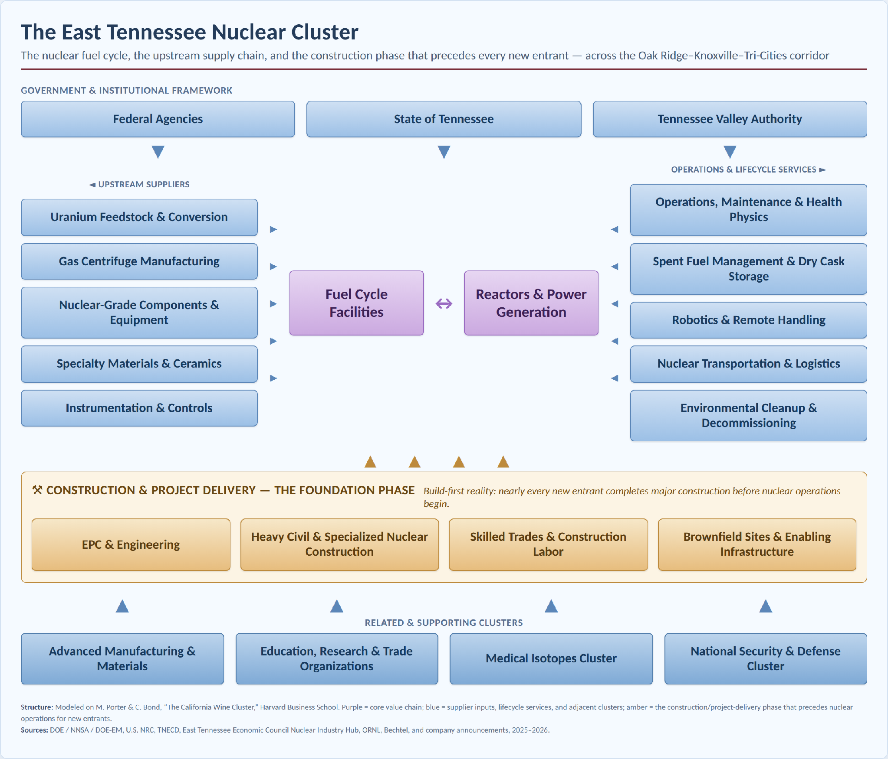
The full fuel cycle and supply chain, plus the construction phase that precedes every new entrant
New Nuclear
Build-first reality: nearly every new entrant constructs before it goes nuclear.
Notes:
[~0:45] Enrichment (Orano, Centrus, BWXT), fuel fabrication (TRISO-X, Standard Nuclear), reactors (Clinch River SMR, Kairos). Construction is the current dominant activity.

Slide 6
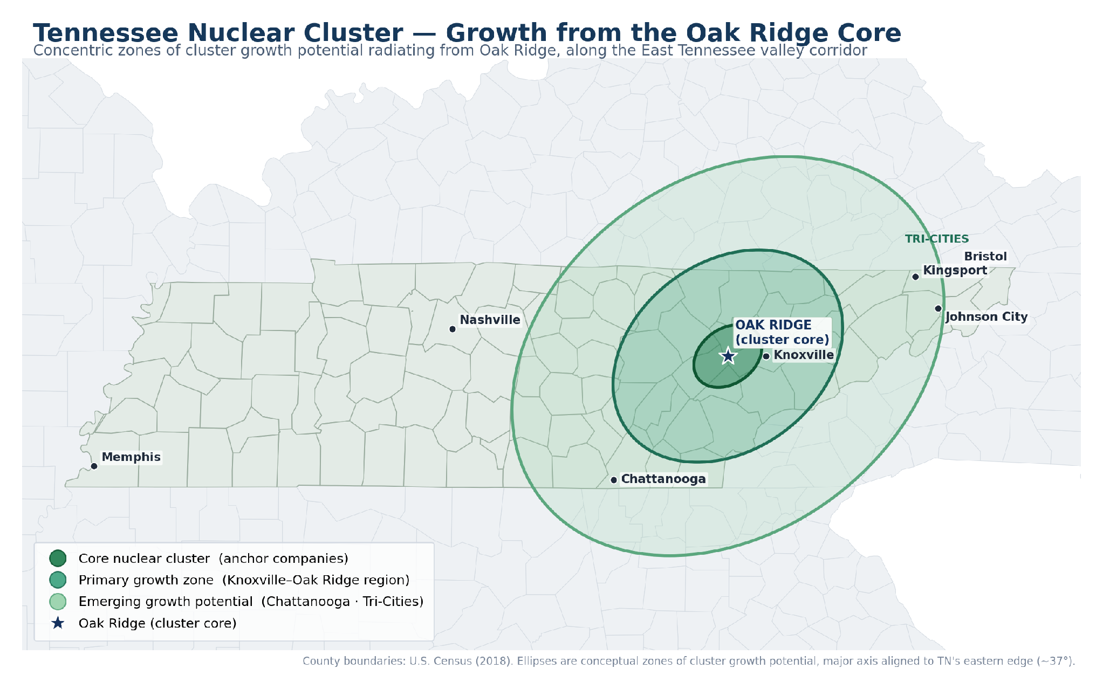
Tennessee Nuclear Cluster – Oak Ridge Epicenter
Collaboration, partnerships, and impacts reach beyond the Knoxville-Oak Ridge region

Slide 7

Make East Tennessee the new nuclear commercialization hub
Establish East Tennessee as the leading integrated hub for nuclear commercialization, supply-chain development, and real-world deployment.
Why this priority
Unique concentration across R&D, utility operations, manufacturing, workforce & deployment
Compute demand for AI & quantum is growing exponentially
Advanced nuclear is moving from research to commercialization — a time-limited window
Value accrues to places that control commercialization, manufacturing & deployment
Creates high-wage jobs, export industries, talent attraction & cross-sector spillovers
Confident, deployment-first ambition — “looking for a bigger target.”
Notes:
[~1:00] This is the keystone bet. The window is now — advanced nuclear is commercializing, and value flows to whoever owns deployment and supply chain. The poster sets the tone.

Slide 8

Nuclear Commercialization Execution — 12-Month Plan
Regional effort with statewide partnership and impact
Nuclear Commercialization
Launch a Nuclear Supply Chain Working Group
Establish a Nuclear Pilot & Deployment Program
Continue executing targeted company recruitment
Launch Founder & Supplier Development to enable the supply chain
Notes:
Create a structured process for nuclear supply chain companies to test/pilot and connect with customers and partners here

Slide 9
Nuclear Commercialization - 90-Day Activation & First-Year Targets
Days 1–30
Days 31–60
Days 61–90
Convene leadership; adopt the regional ambition
Draft the regional cluster map
Launch first visible initiatives
Deliverable: signed charter
Inventory, capability gaps, recruitment targets
Pilot · venture fund · recruitment mission · supplier initiative
First-year targets
10+
3+
15+
company recruitment opportunities
pilots launched
new nuclear firms engaged
$25M+
250+
private capital committed
students & workers connected
Notes:
[~0:50] 90 days to a signed charter, a first-draft cluster map, and visible wins. Targets are external and measurable — visits, hires, pilots, capital, relocations.

Slide 10
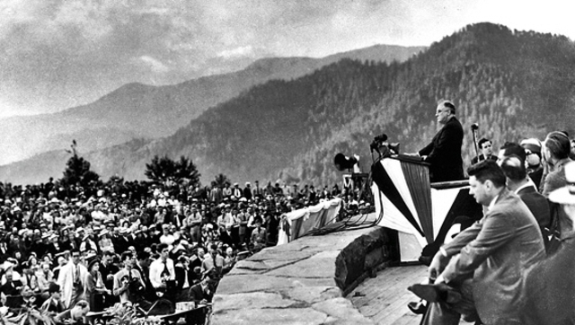
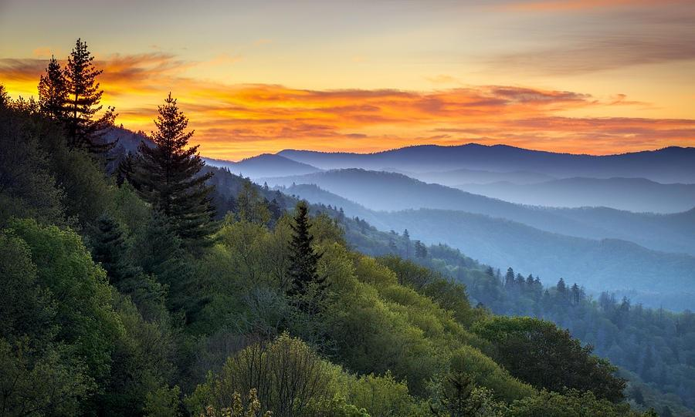
Frontier heritage, traditional tourism, modern amenities
East Tennessee’s natural resources provide a variety of opportunities from traditional offerings to adventurous outings for all.
Unique strengths
A day’s drive from 75% of the Nations’s population
Great Smoky Mountain’s National Park is the most visited park in the Nation
A hub for adventure tourism (rafting, hiking, biking)
2 of the top 4 counties for visitation are in East Tennessee (Knox, Sevier – with all 16 counties in the top third for the state of Tennessee)
“The Smokies always call me home”.

Slide 11
East Tennessee Tourism, by the Numbers
The region’s visitor economy across the East Tennessee grand division — 2024
$9.4B+
12.2M
$3.93B
combined visitor spending — East TN
Great Smoky Mountains visits — the most-visited U.S. national park
Sevier County (Gatlinburg · Pigeon Forge) — 3rd of 95 TN counties
3 of 5
$2.8B
3.14M
of Tennessee’s top visitor-spending counties are in East Tennessee
the Smokies’ benefit to gateway communities — highest of any national park
Dollywood guests — a top-20 North American theme park
Within Tennessee’s record $31.7B visitor economy (147M visits, $3.3B state & local tax). Sources: TDTD / Tourism Economics 2024; NPS; TEA.

Slide 12
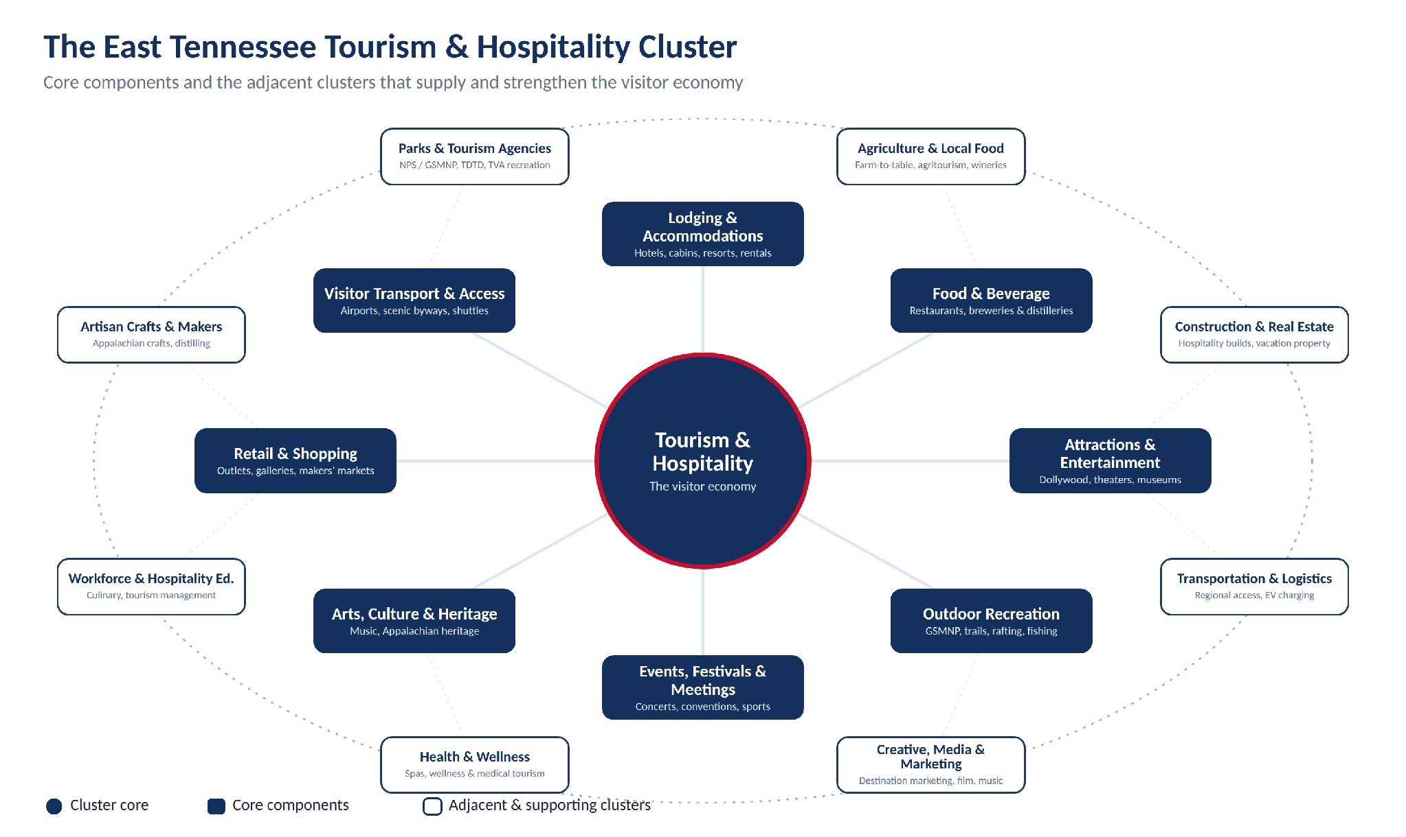
Components and adjacent clusters of the visitor economy
Tourism Cluster
Notes:
[~0:55] Three clusters, one system. Tourism funds it, nuclear powers it, AI/quantum is the upside. The overlaps are the strategy — especially AI·Nuclear·Quantum.

Slide 13
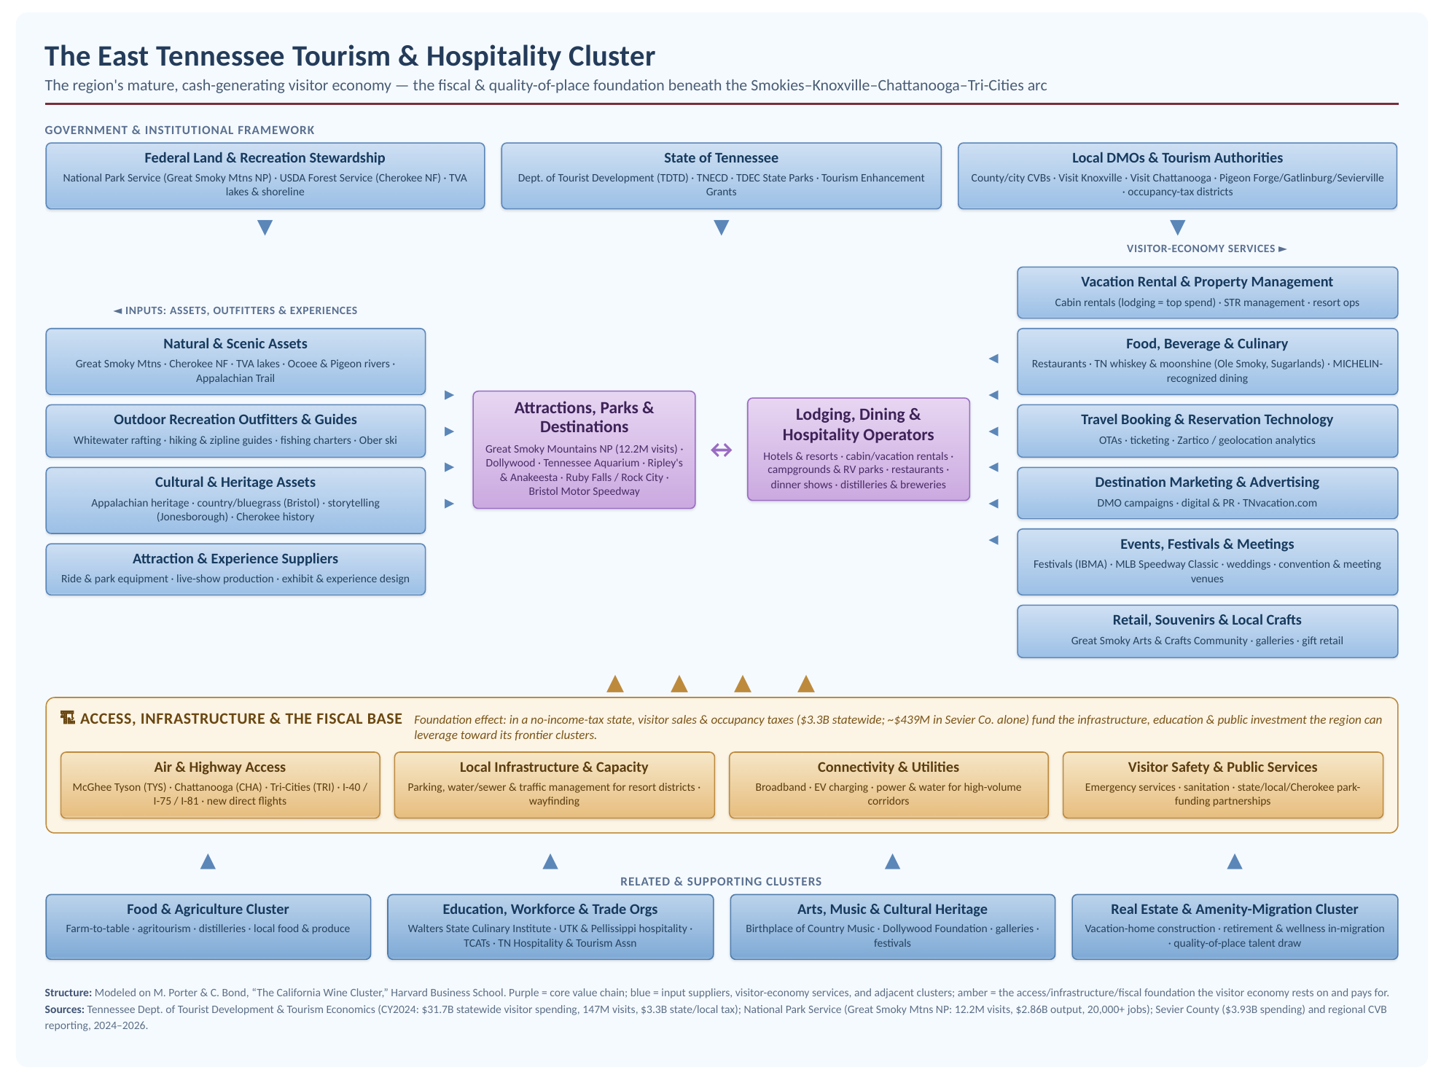
$31.7B statewide visitor spending · 12.2M Smokies visits · $3.3B state & local tax
Tourism
The visitor economy that funds the build-out — and the talent magnet that helps retain it.
Notes:
[~0:45] In a no-income-tax state, tourism's sales & occupancy taxes fund the public investment the frontier needs. It's also the livability draw for high-skill talent.

Slide 14
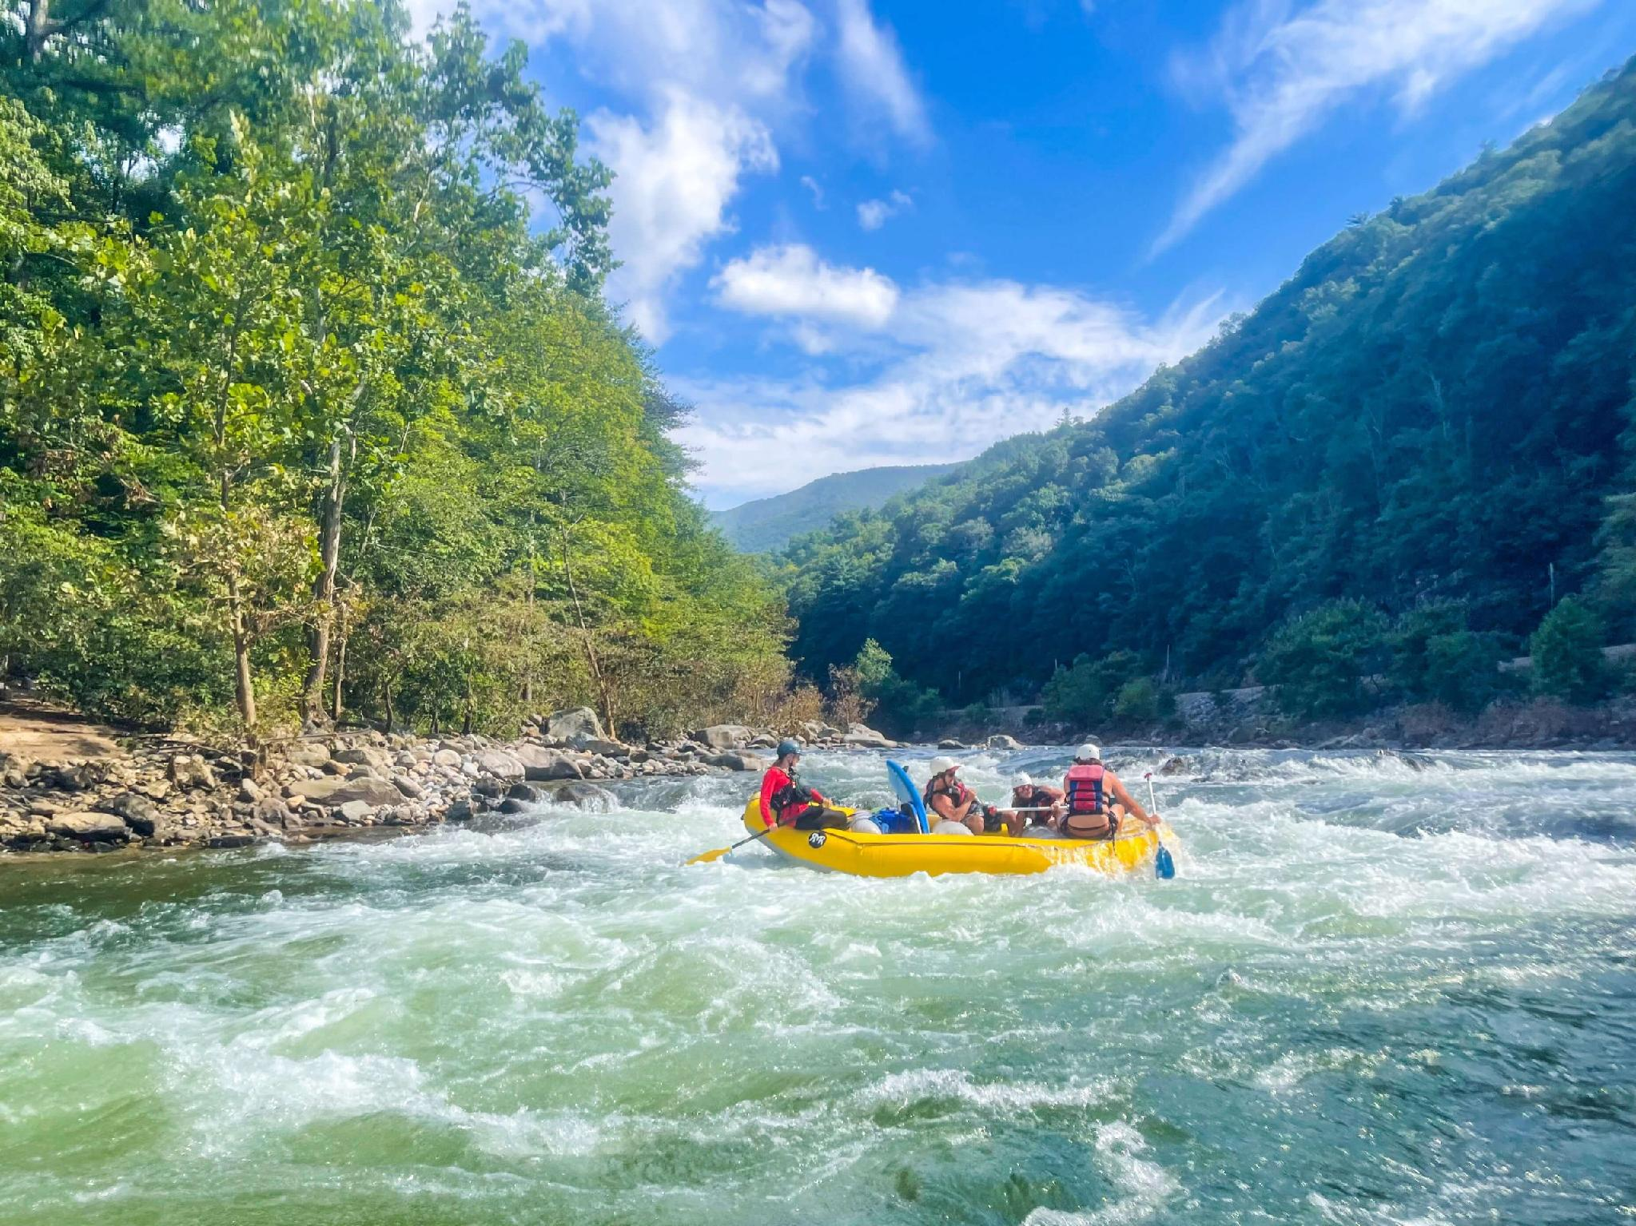
Make East Tennessee the destination of choice
Leverage East Tennessee’s natural resources, outdoor adventures and volunteer spirit to attract visitors from around the globe.
Why this priority
Level of economic impact across multiple regions
Leverage Tennessee’s natural beauty and resources
Creates jobs and cross-sector impacts
East Region tourist spend annually is $7.6B (up 42% from 2018)
Direct visitor spending is $31.66B annually for Tennessee

Slide 15

Execution — 12-Month Plan
Regional effort with statewide partnership and impact
Tourism Competitiveness
Develop micro-clusters (Mountain biking, moonshine)
Build upon our foundation endowments (natural resources, Smokies, Tennessee River)
Grow revenues in adjoining counties
Develop more attractions
Notes:
Create a structured process for nuclear supply chain companies to test/pilot and connect with customers and partners here

Slide 16
90-Day Activation & First-Year Targets
Days 1–30
Days 31–60
Days 61–90
Convene leadership; adopt the regional ambition
Draft the regional cluster map
Launch first visible initiatives
Deliverable: signed charter
Inventory, capability gaps, recruitment targets
Pilot · venture fund · recruitment mission · supplier initiative
First-year targets
25%+
0
15%+
Increase in travel related expenditure for the region
Remove all counties in East Tennessee from the distressed county classification
Increase number of multiple night stays throughout the region
Notes:
[~0:50] 90 days to a signed charter, a first-draft cluster map, and visible wins. Targets are external and measurable — visits, hires, pilots, capital, relocations.

Slide 17
When we succeed — East Tennessee, 2036
The nation’s new nuclear commercialization capital — build, test & scale here
An energy-to-compute flywheel powering AI & quantum on clean, firm nuclear power
A visitor economy that brings benefits and keeps talent throughout the 16-county region and beyond
High-wage jobs, export industries, and a magnet for people and capital
Partnerships are built before you need them.
Notes:
[~0:30] Close on the vision and the maxim. Build the partnerships, pipelines, and infrastructure before the demand fully arrives — that's how the region wins.

Slide 18

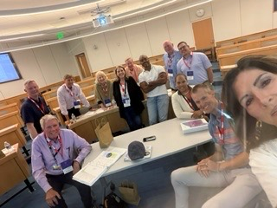
Thank you
East Tennessee — Foundation to Frontier
Knoxville–Oak Ridge Region · Questions & discussion
12
Notes:
[~0:10] Close. Invite questions. Total run time ~8 minutes.

